Slide 1
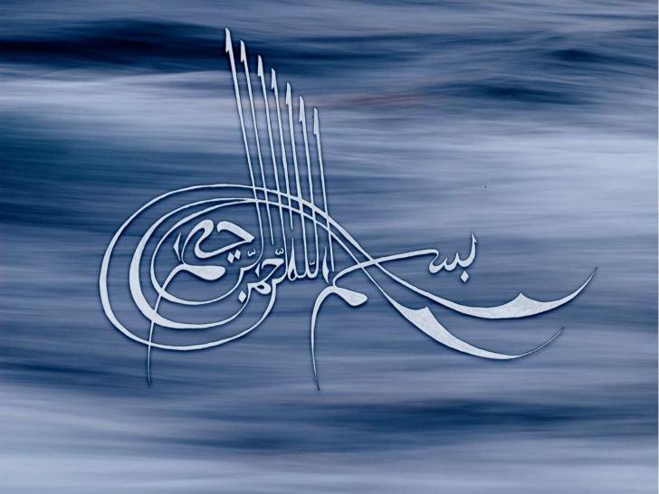

Slide 2
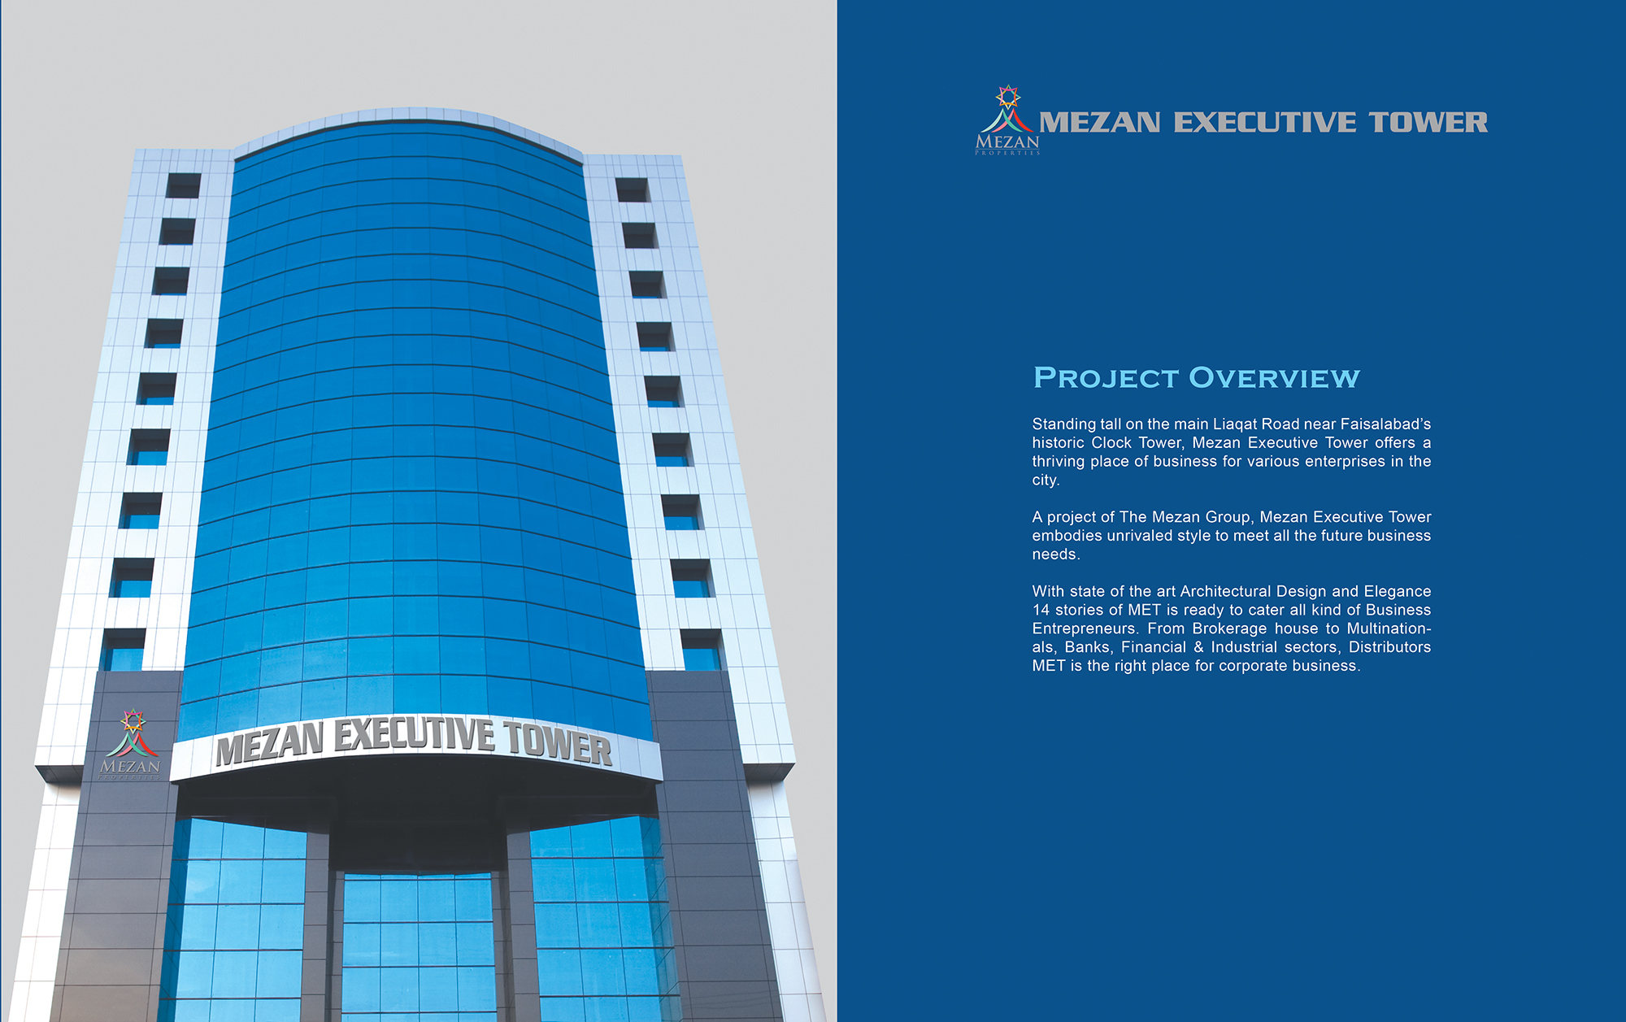
No. of floors: 18
Parking floors: 02
Corporate floors: 14
Service floor: 02

Slide 3
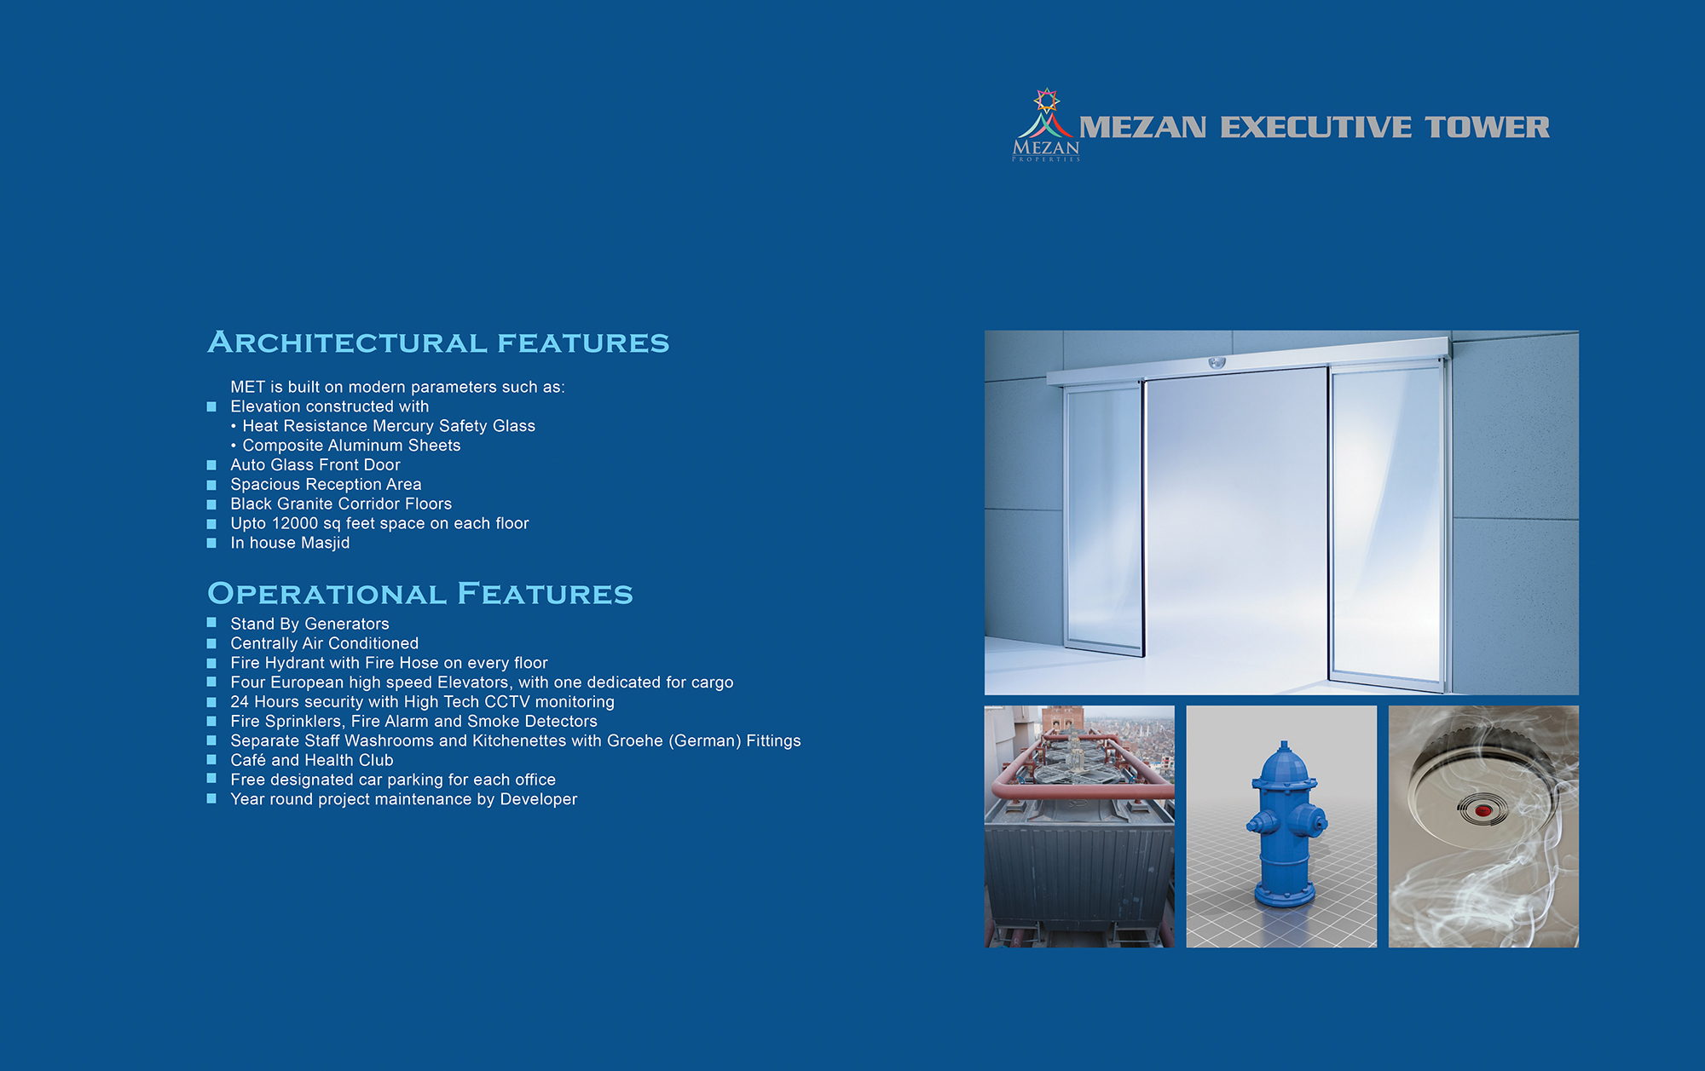

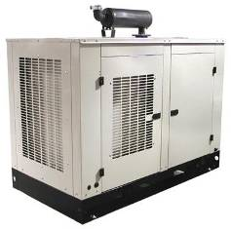
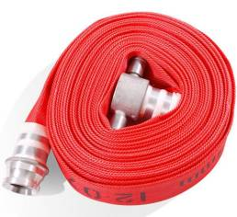
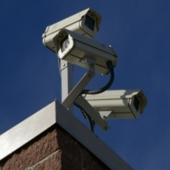
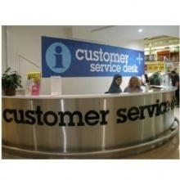
Mezan Executive Tower

Slide 4
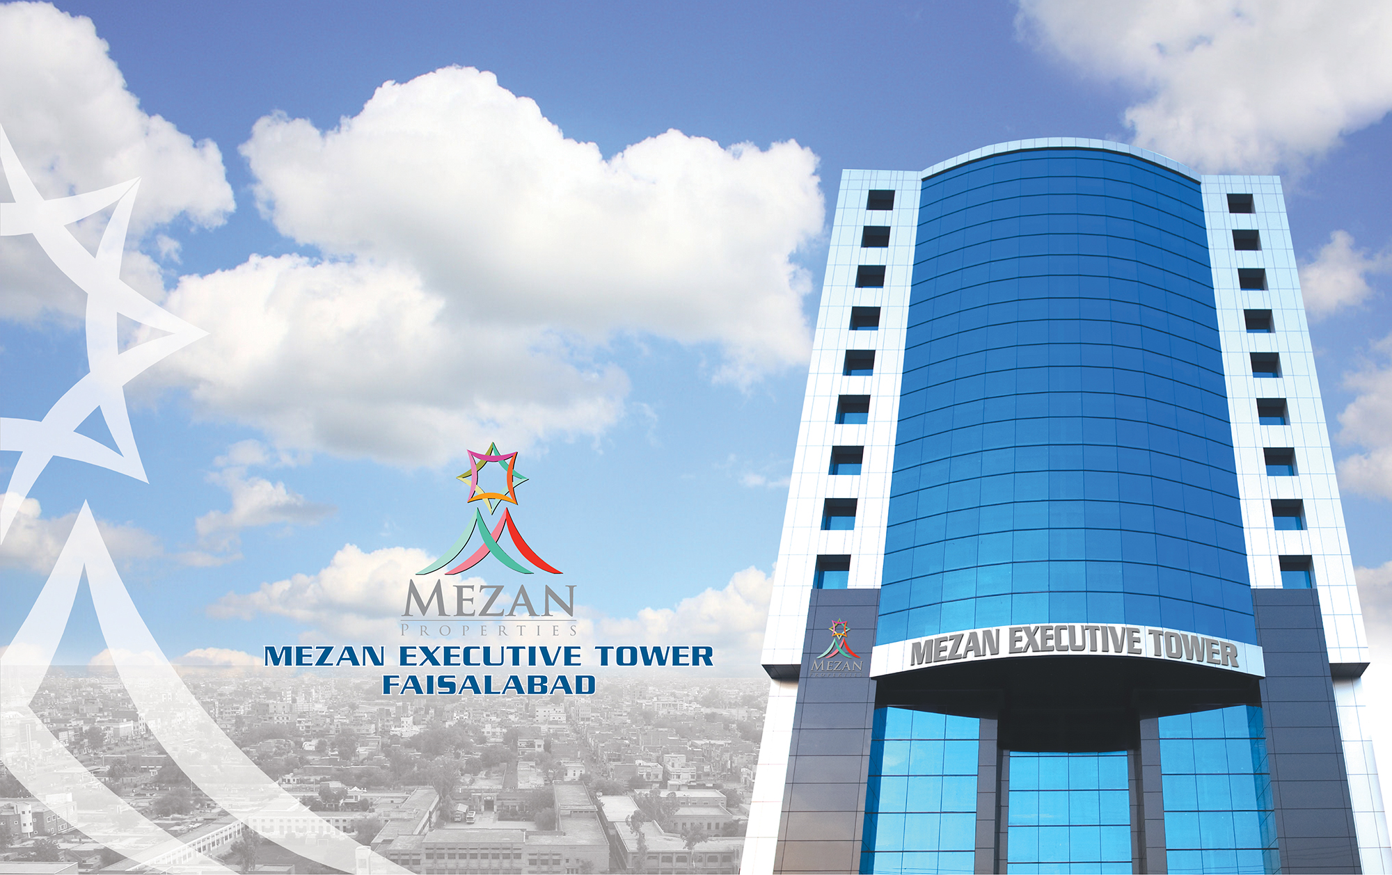


Slide 5
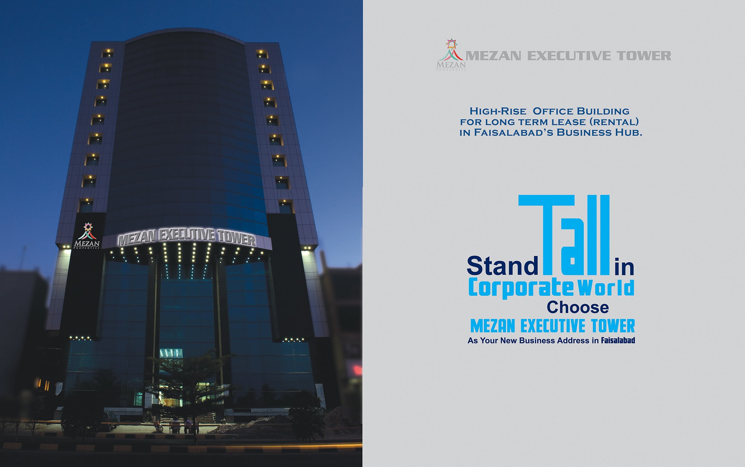

Slide 6
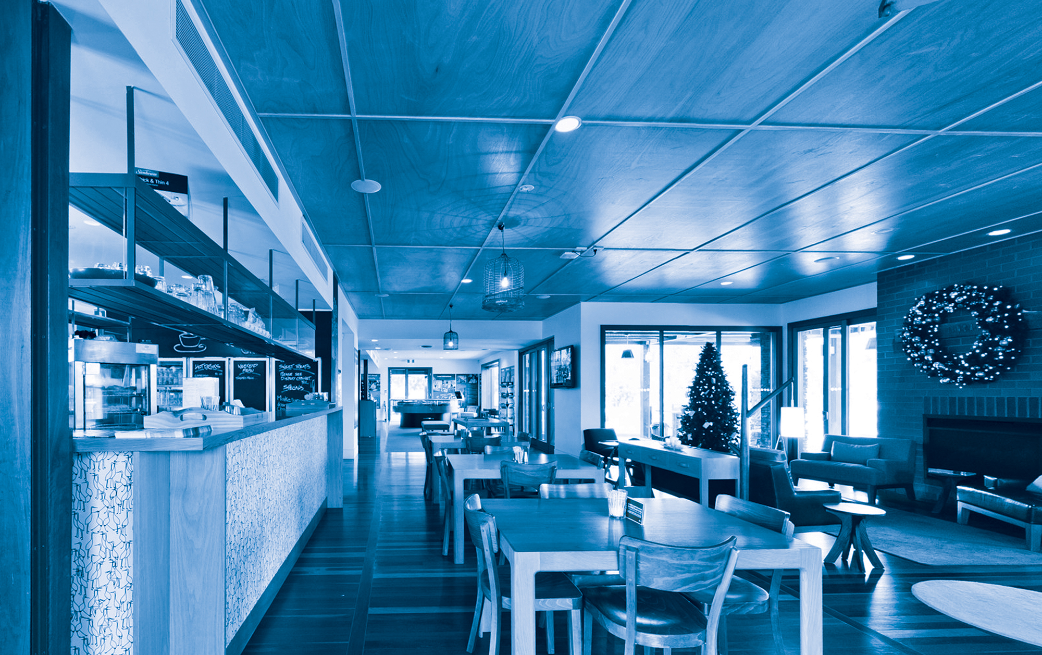
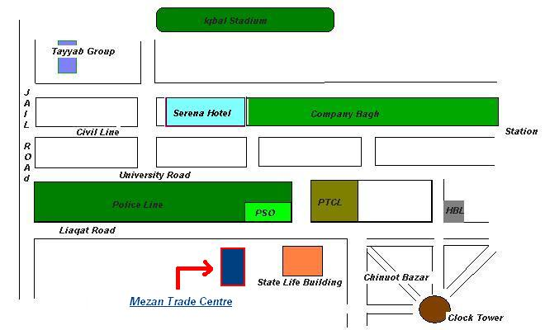
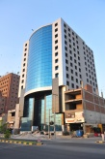
Project Location Map
Mezan Executive Tower
Mezan Executive Tower

Slide 7


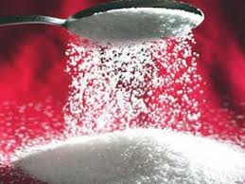
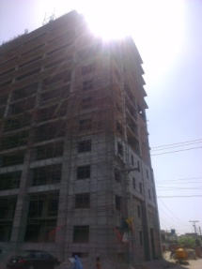
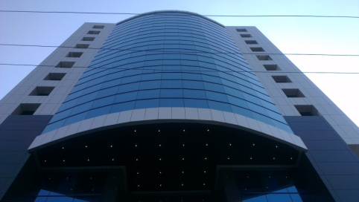






People Behind The Project
Mezan Group www.mezandevelopers.com
Edible Oil
Banaspati
Industrial Margarine
HORECA Specialties
Sugar & Allied
Construction

Slide 8
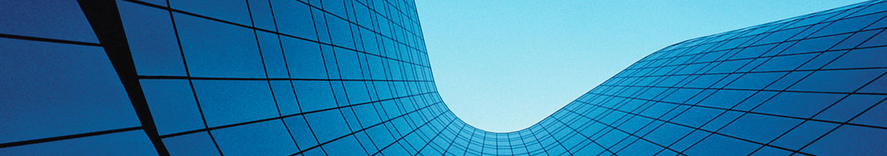

Colliers International Pakistan (Pvt.) Ltd.
Mr. Umar
Dear Mr. Umar
Amongst the “Big Four” Property Advisory Firms, Colliers International is the only global firm with operational offices in Pakistan. We specifically deal and specialize in real estate sector including mixed use development, residential, commercial, hospitality, retail and industrial projects.
In Pakistan, started our operations in 2007 with head office in Karachi, Our Central Region Office in Lahore with 2 site offices in Liberty & Fortress Stadium Lahore, 1 site office in Faisalabad and a Northern Region Office in Islamabad with site office at Country Club Apartments on Murree - Islamabad Expressway
Further to our credentials, we would like to propose to you, a prime opportunity to have your office in an environment which meets your corporate goals as well as give you a competitive advantage interms of location in Faisalabad. Meezan Executive Tower is a commercial project based in the heart of Faisalabad's central business district on Liaqat Road and is available for lease only. The project has been successfully launched and ready to move in

Slide 9
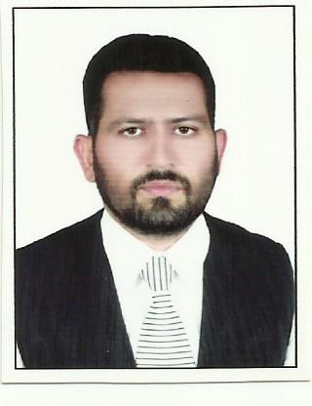



Available for Lease
Option A
Space available: 976 sq.ft
Floor Available: 1st Floor
Monthly Rent: Rs. 70 (0.7 USD) per sqft
Terms & Conditions:
HVAC & Service Charge: Rs. 30 (0.3 USD)per sqft/month
Minimum Agreement Tenure: 10Years
Name: Fahad Majeed
Designation: Manager - Leasing I Sale
Contact Details:
Main +92 41 2540501
Mob +92 346 8211 037
Fax +92 41 2620439
Email fahadmajeed.colliers@gmail.com
www.colliers.com/country/Pakistan

Slide 10
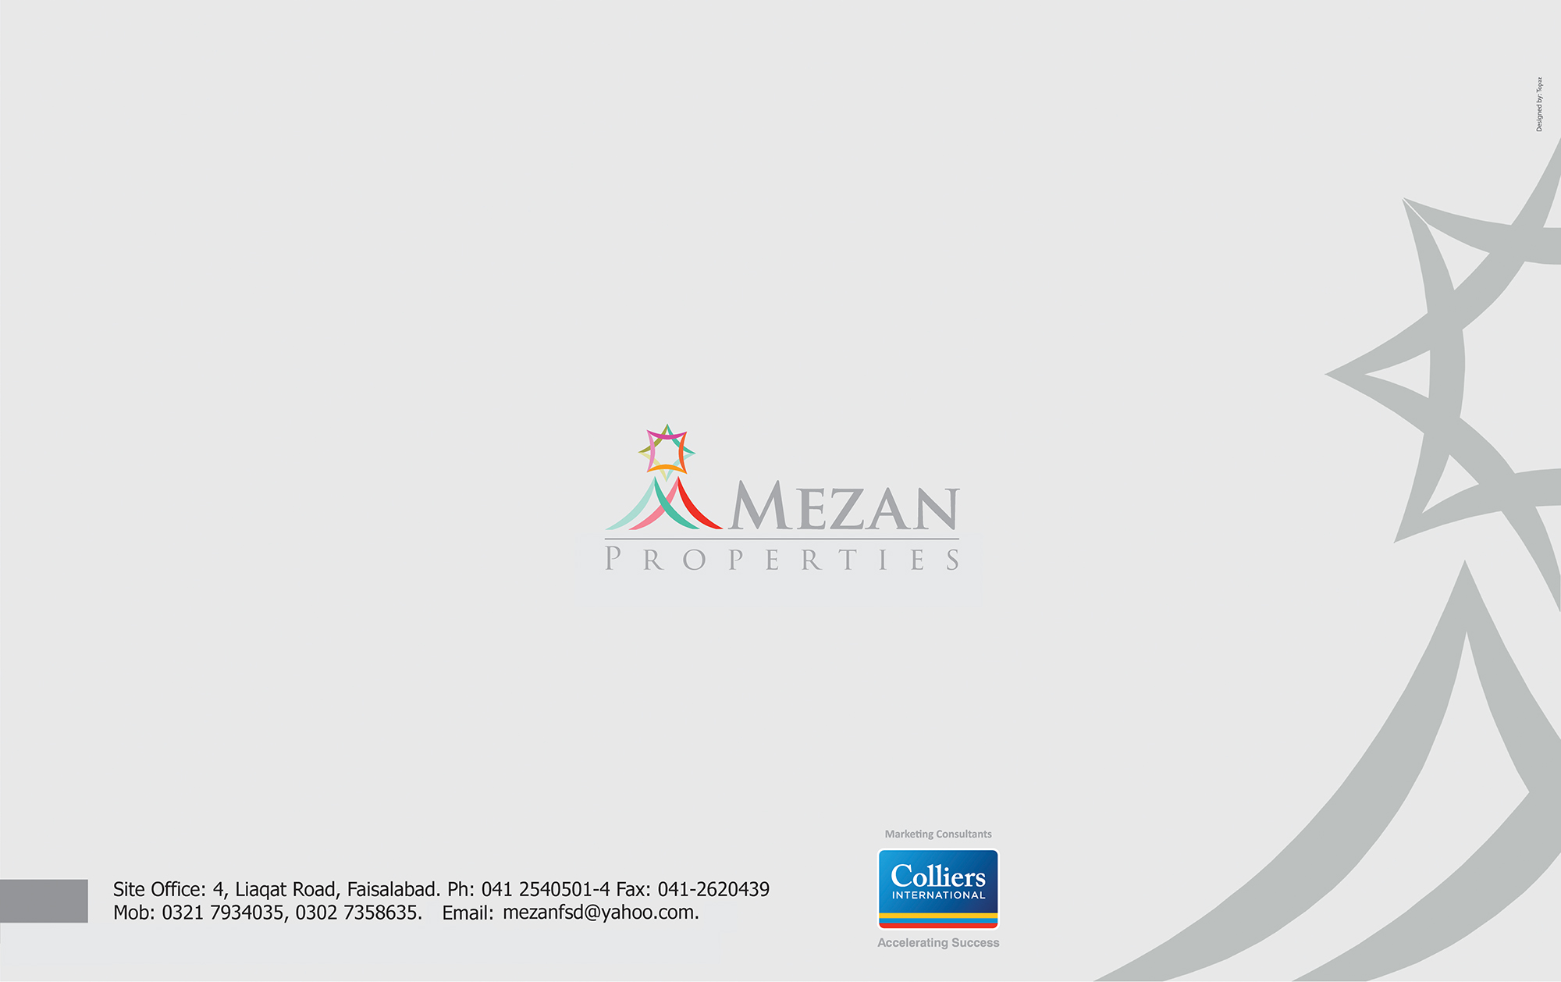
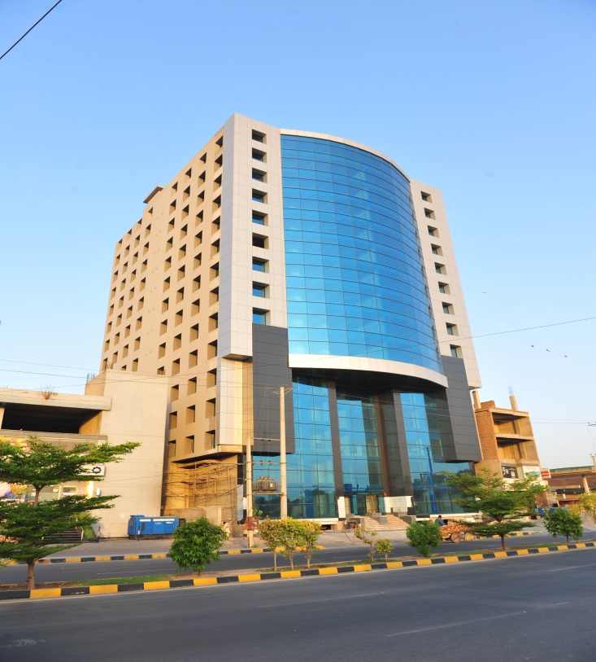
Marketing Consultants
Accelerating Success
Mezan Executive Tower

